Slide 1
Inflation Report August 2019
Supply and the labour market

Slide 2
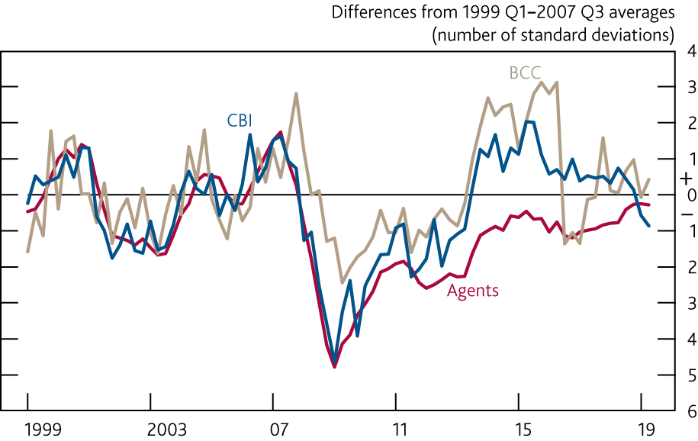
Chart 3.1 Some indicators suggest that companies are operating a little below normal capacity
Survey indicators of capacity utilisation^{(a)}
Sources: Bank of England, BCC, CBI, CBI/PwC, ONS and Bank calculations.
(a) Measures are produced by weighting together surveys from the Bank’s Agents, the BCC (non-services and services) and the CBI (manufacturing, financial services, business/ consumer/professional services and distributive trades) using shares in nominal value added. The BCC data are not seasonally adjusted. The Agents’ data for 2019 Q2 are for May.

Slide 3
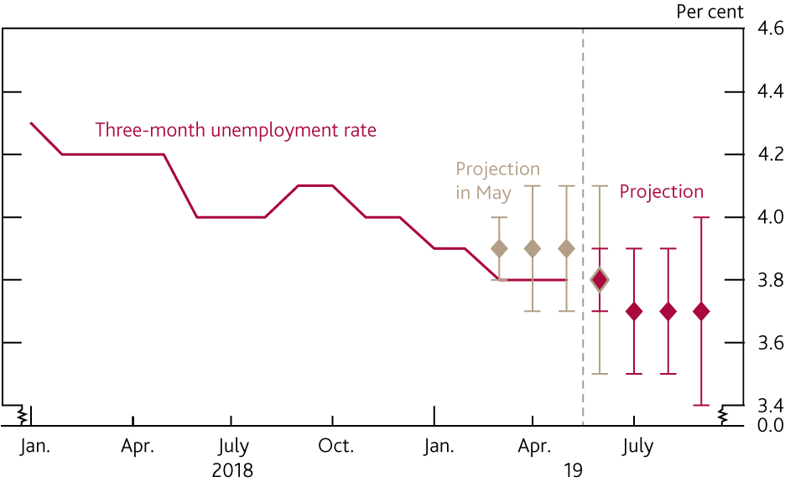
Chart 3.2 The unemployment rate is expected to fall slightly to
3.7% in 2019 Q3
Unemployment rate and Bank staff’s near-term projection^{(a)}
Sources: ONS and Bank calculations.
(a) The beige diamonds show Bank staff’s central projections for the headline unemployment rate for the three months to March, April, May and June 2019 at the time of the May 2019 Report. The red diamonds show the current staff projections for the headline unemployment rate for the three months to June, July, August and September 2019. The bands on either side of the diamonds show uncertainty around those projections based on one root mean squared error of past Bank staff projections for the three-month headline unemployment rate.

Slide 4
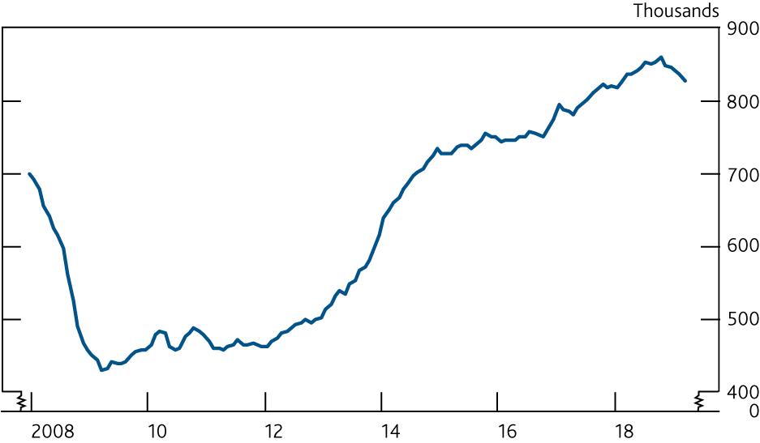
Chart 3.3 There are signs that demand for labour may have eased
Number of vacancies

Slide 5
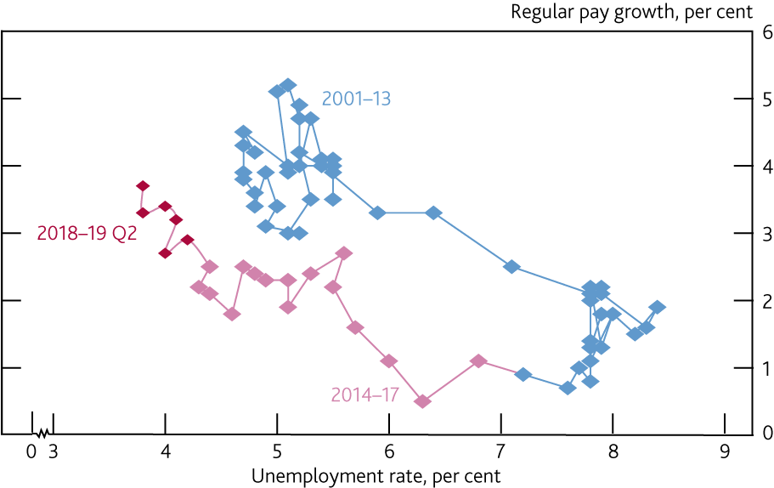
Chart 3.4 Wage growth has picked up as the unemployment
rate has fallen
Wage Phillips curve: wages and unemployment^{(a)}
(a) Whole-economy AWE total pay excluding bonuses and arrears of pay. Percentage change on a year earlier. Diamond for 2019 Q2 shows Bank staff’s projections, based on data to May.

Slide 6
Tables

Slide 7
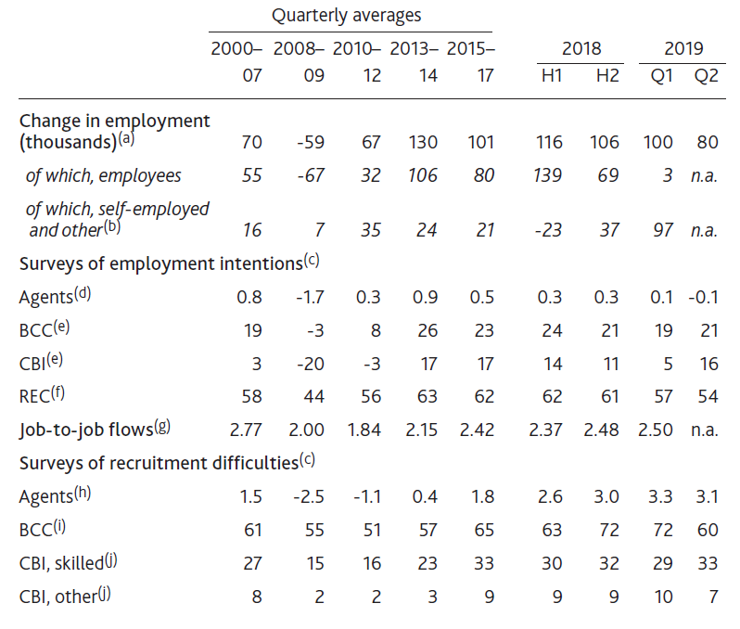
Table 3.A The labour market remains tight
Selected measures of labour demand and labour market tightness
Sources: Bank of England, British Chambers of Commerce (BCC), CBI, CBI/PwC, KPMG/REC/IHS Markit, ONS and Bank calculations.
(a) Changes relative to the previous quarter. Figure for 2019 Q2 is Bank staff’s projection, based on data to May.
(b) Other comprises unpaid family workers and those on government-supported training and employment programmes classified as being in employment.
(c) Measures for the Bank’s Agents, the BCC (non-services and services) and CBI (manufacturing, financial services and business/consumer/professional services; employment intentions also include distributive trades) are weighted together using employee job shares from Workforce Jobs. BCC data are not seasonally adjusted. Agents data are last available observation for each quarter.
(d) The scores are on a scale of -5 to +5, with positive scores indicating stronger employment intentions over the next six months relative to the previous three months.
(e) Net percentage balance of companies expecting their workforce to increase over the next three months.
(f) Quarterly average. Recruitment agencies’ reports on the demand for staff placements compared with the previous month. A reading above 50 indicates growth on the previous month and below 50 indicates a decrease.
(g) Proportion of people who reported being in a job three months ago who report being in a job for less than three months.
(h) The scores are on a scale of -5 to +5, with positive scores indicating greater recruitment difficulties in the most recent three months relative to normal.
(i) Percentage of respondents reporting recruitment difficulties over the past three months.
(j) Net percentage of respondents expecting skilled or other labour to limit output/business over the next three months (in the manufacturing sector) or over the next 12 months (in the financial services and business/ consumer/professional services sectors).

Slide 8
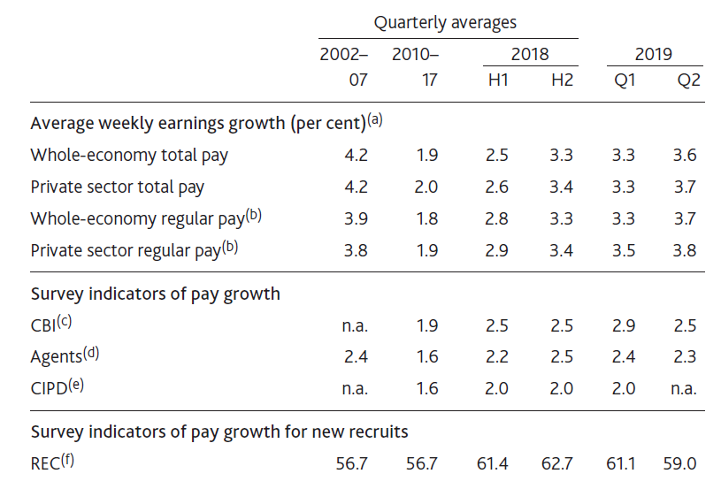
Table 3.B Survey indicators suggest pay growth is likely to
stabilise
Indicators of pay growth
Sources: Bank of England, CBI, Chartered Institute of Personnel and Development (CIPD), KPMG/REC/IHS Markit, ONS and Bank calculations.
(a) Three-month average growth on the same period a year earlier. Figures for 2019 Q2 are Bank staff’s projections, based on data to May.
(b) Total pay excluding bonuses and arrears of pay.
(c) Measures of expected pay for the year ahead. Produced by weighting together responses for manufacturing, distributive trades, business/consumer/professional services and financial services using employee job shares. Data for financial services only available since 2009 Q1, and other sectors since 2008 Q2.
(d) The scores refer to companies’ labour costs over the past three months compared with the same period a year earlier. Scores of -5 and 5 represent rapidly falling and rapidly rising costs respectively, with zero representing no change. Services and manufacturing scores are weighted together using employee job shares from Workforce Jobs.
(e) Pay increase intentions excluding bonuses over the coming year. Data only available since 2012.
(f) Quarterly averages for the pay of permanent and temporary new placements weighted together using LFS employee job shares. A reading above 50 indicates growth on the previous month and below 50 indicates a decrease.

Slide 9
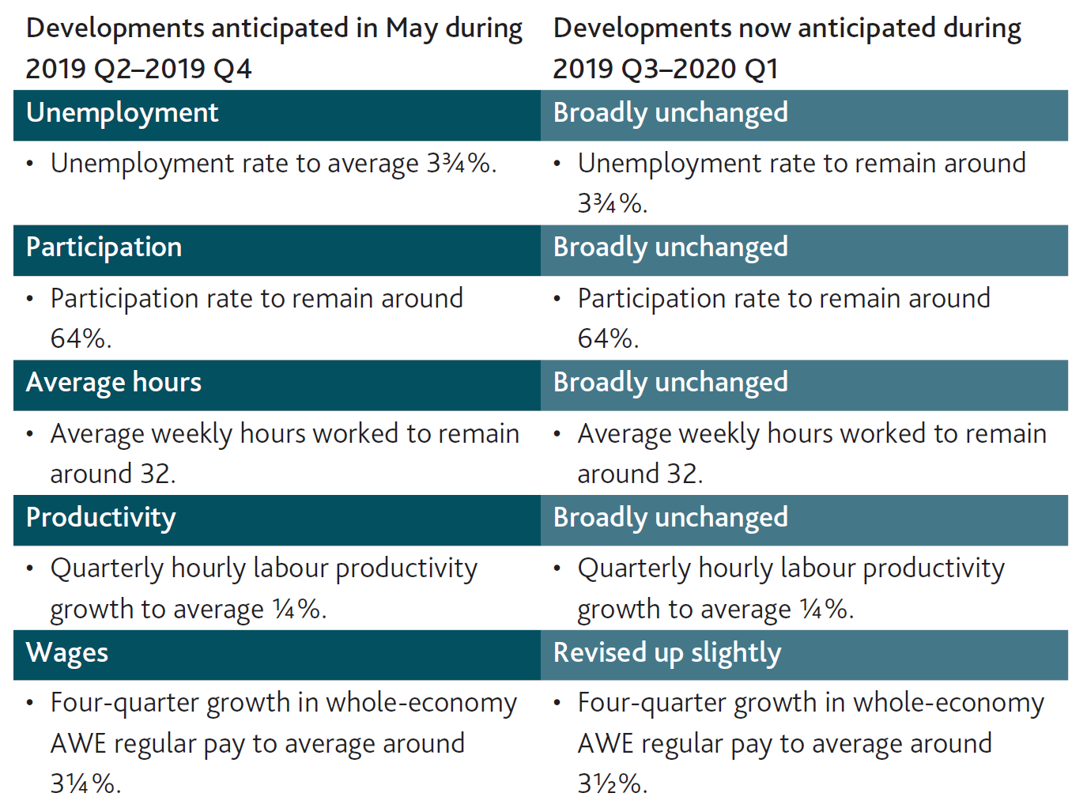
Table 3.C Monitoring the MPC’s key judgements

Slide 10
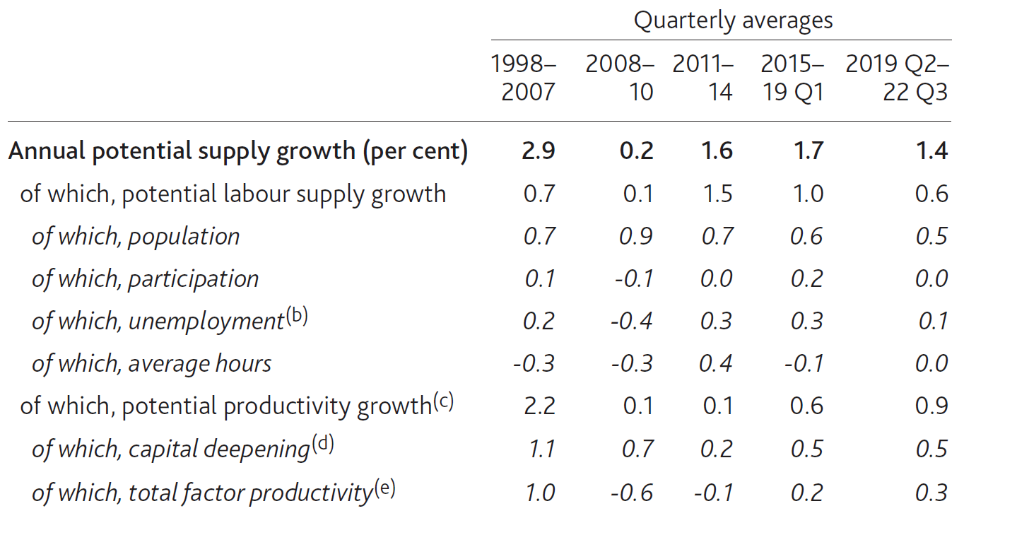
Table 3.D Potential supply growth is projected to remain subdued
Decomposition of estimated potential supply growth^{(a)}
Sources: ONS and Bank calculations.
(a) Average percentage point contributions to annual growth unless otherwise specified. Contributions may not sum to the total due to rounding.
(b) Positive numbers indicate that a fall in the equilibrium unemployment rate has increased potential labour supply.
(c) The decomposition is based on a growth-accounting framework using a constant returns to scale Cobb-Douglas production function, with total output to capital elasticity of ⅓. Total factor productivity is a residual.
Capital deepening refers to growth in capital services per person-hour. Capital includes structures, machinery, vehicles, computers, purchased software, own-account software, mineral exploration, artistic originals and R&D. Calculations are based on Oulton, N and Wallis, G (2016), ‘Capital stocks and capital services: integrated and consistent estimates for the United Kingdom, 1950–2013’, Economic Modelling.
Total factor productivity growth refers to improvements in the efficiency with which both capital and labour are used to produce output.

Slide 11
Box 4
Capital and labour growth

Slide 12
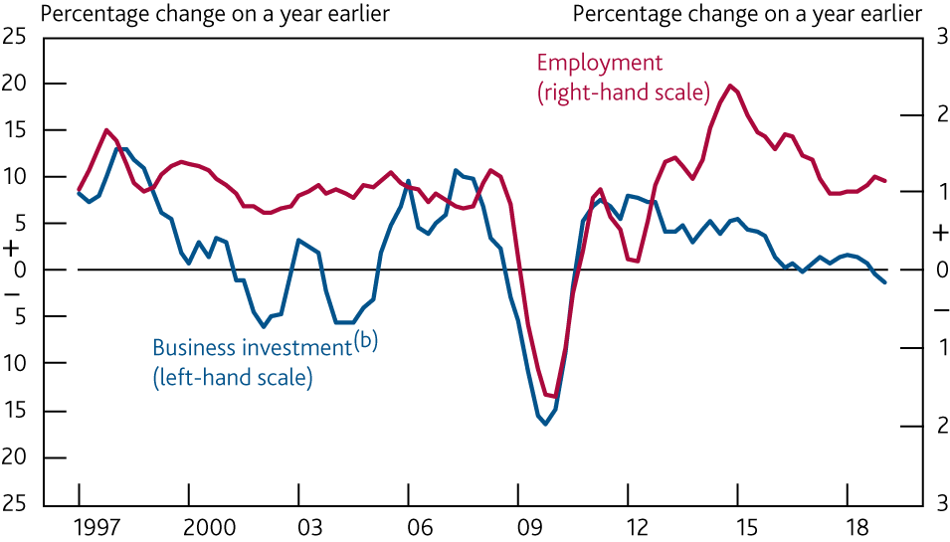
Chart A Investment growth has been weak relative to
employment growth since the crisis
Four-quarter growth in business investment and employment^{(a)}
Sources: ONS and Bank calculations.
(a) Four-quarter moving average growth rate.
(b) Chained-volume measure. Data adjusted for the transfer of nuclear reactors from the public corporation sector to central government in 2005 Q2.

Slide 13
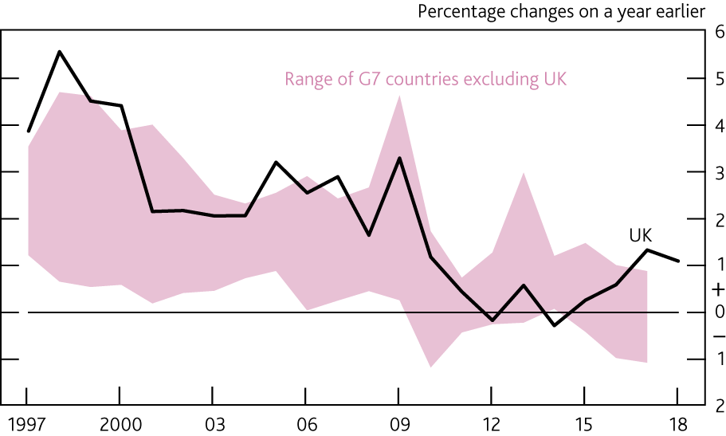
Chart B Growth in capital to labour ratios have been weak
across the G7 economies
G7 capital to labour ratios^{(a)}
Sources: ONS, Penn World Table 9.1 and Bank calculations.
(a) Annual estimates of capital to labour ratios calculated as capital services divided by employment in heads. For the G7 economies (excluding the UK), the estimates of capital services are from Penn World Table. For the calculation of the UK capital to labour ratio, see Chart C footnote (a). UK measure is for the private sector.

Slide 14
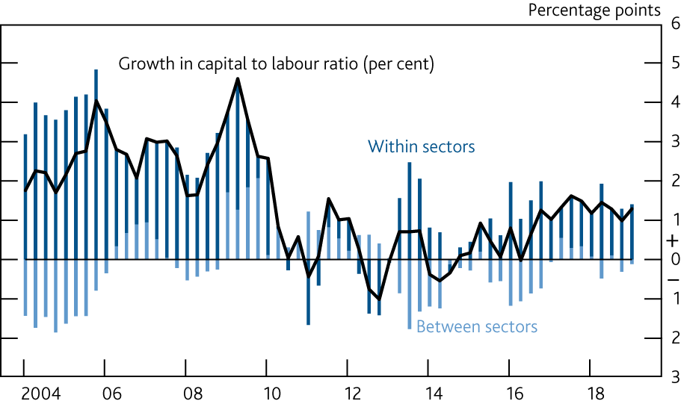
Chart C Subdued growth in the UK capital to labour ratio has
been largely accounted for by lower capital to labour growth
within sectors
Contributions to four-quarter growth in the UK capital to labour ratio^{(a)}
Sources: ONS and Bank calculations.
(a) Total capital to labour ratio calculated as capital services divided by employment in heads. Contributions between sectors calculated using changes in each sector’s relative labour share. Contributions within sectors are residuals.

